Slide 1
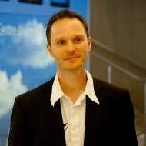
Serverless
Strom kommt aus der Steckdose und IT aus der Cloud
Rainer Stropek
software architects gmbh
Web
Mail
Twitter
http://www.timecockpit.com
rainer@timecockpit.com
@rstropek
Microservices

Slide 2
Why?

Slide 3
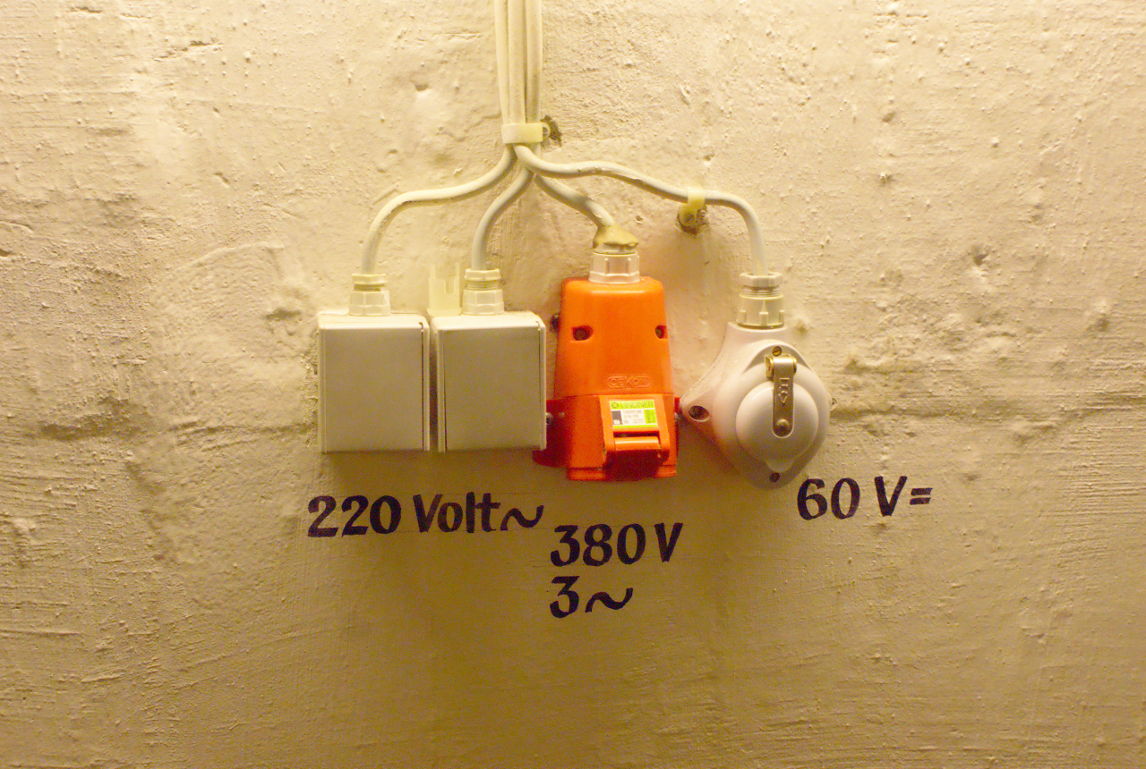
Image Source: https://flic.kr/p/73eSV7

Slide 4
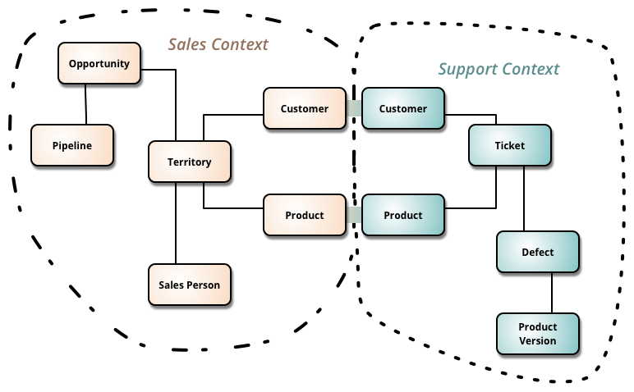
Microservices
Source: http://martinfowler.com/bliki/BoundedContext.html

Slide 5
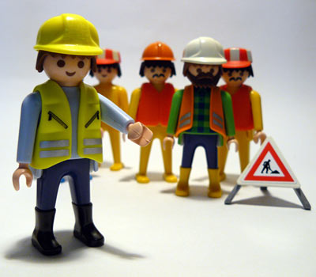
Autonomous Teams
Image Source: https://flic.kr/p/4JGGFW

Slide 6
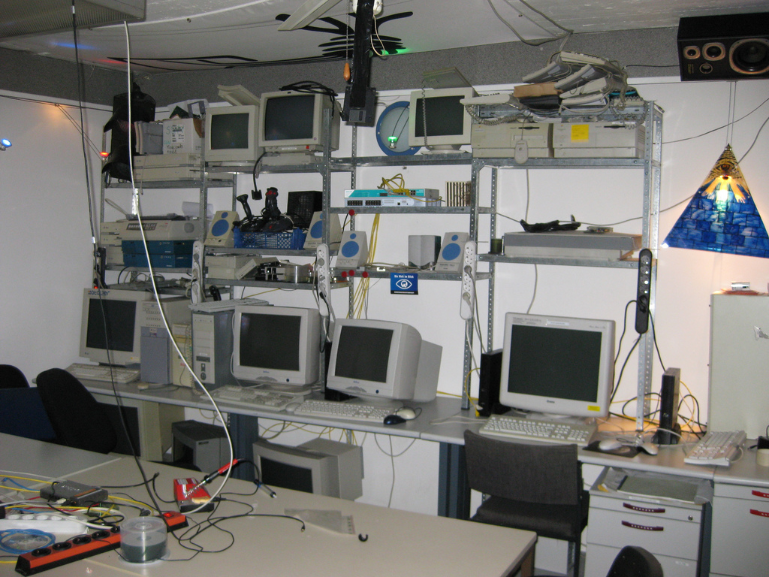
Image Source: https://flic.kr/p/5VB88j

Slide 7
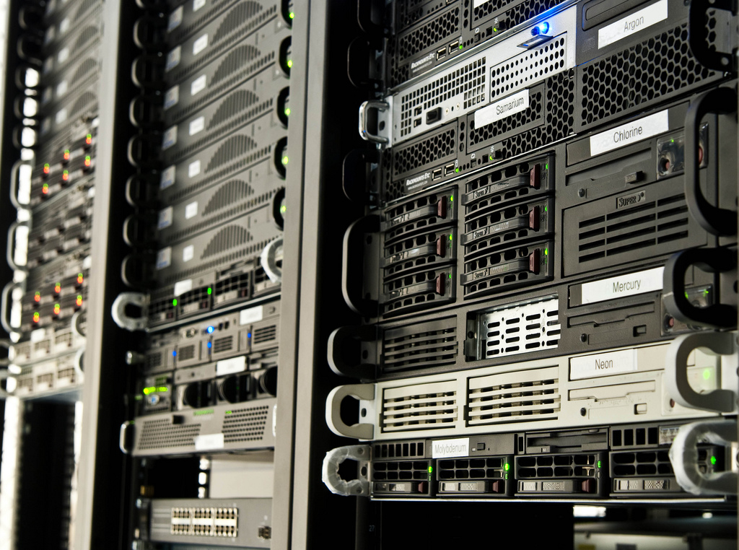
Image Source: https://flic.kr/p/65RcDT

Slide 8

Image Source: https://flic.kr/p/5qtj4r

Slide 9
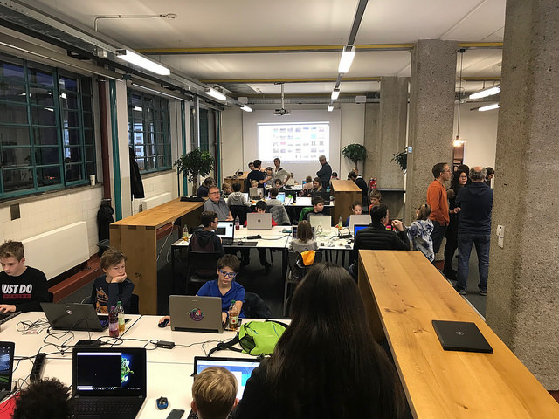


Slide 10
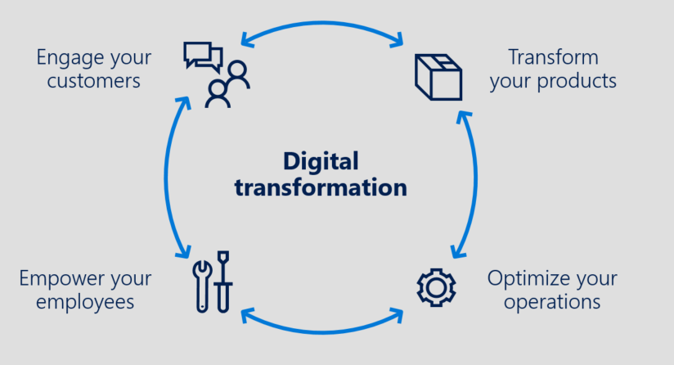
From IaaS to … Innovation with PaaS
Advanced Analytics & Big Data, IoT, App Innovation / Intelligent Apps / Serverless …
PaaS
DIFFERENTIATION
VALUE TO BUSINESS
Storage, Back-up & DR
INNOVATION
APPLICATIONS AND SERVICES
Compute & Networking
EFFICIENCY
IaaS
TIME

Slide 11
Why Not?

Slide 12

Trust is Required
Image Source: https://flic.kr/p/9nWs1

Slide 13
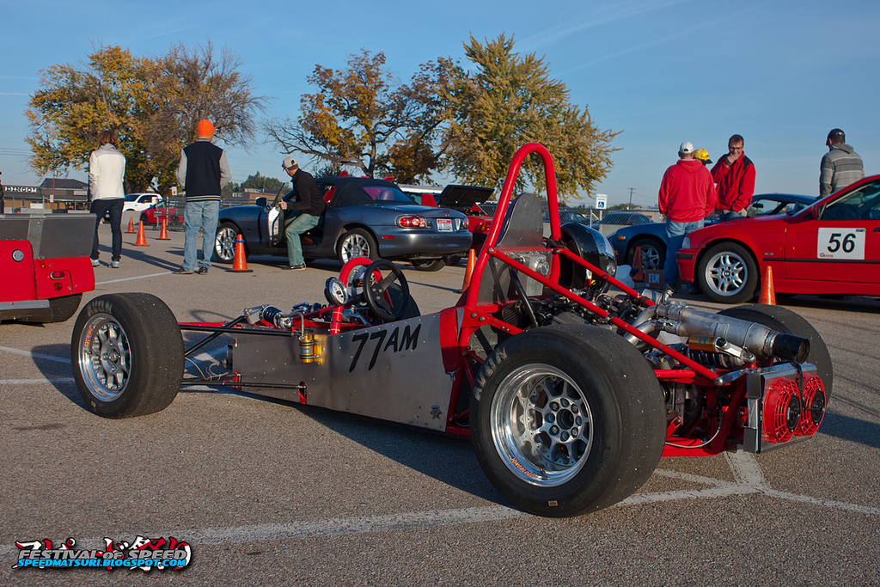
Specific Needs
Image Source: https://flic.kr/p/gWCWqU

Slide 14
Demo

Slide 15
C# Function
using System.Net;
public static async Task<HttpResponseMessage> Run(HttpRequestMessage req, TraceWriter log) {
log.Info("Received Tic-Tac-Toe request");
var board = await req.Content.ReadAsAsync<string[]>();
if (board.Length != 9) {
return req.CreateResponse(HttpStatusCode.BadRequest, "No valid tic-tac-toe board");
}
for(var row = 0; row < 3; row ++) {
if (!string.IsNullOrWhiteSpace(board[row * 3])
&& board[row * 3] == board[row * 3 + 1] && board[row * 3] == board[row * 3 + 2]) {
return BuildResponse(req, board[row * 3]);
}
}
for(var column = 0; column < 3; column ++) {
if (!string.IsNullOrWhiteSpace(board[column])
&& board[column] == board[3 + column] && board[column] == board[2 * 3 + column]) {
return BuildResponse(req, board[column]);
}
}
if (!string.IsNullOrWhiteSpace(board[0])
&& board[0] == board[3 + 1] && board[0] == board[2 * 3 + 2]) {
return BuildResponse(req, board[0]);
}
if (!string.IsNullOrWhiteSpace(board[2])
&& board[2] == board[3 + 1] && board[2] == board[2 * 3]) {
return BuildResponse(req, board[1]);
}
return BuildResponse(req);
}
private static HttpResponseMessage BuildResponse(HttpRequestMessage req, string winner = null)
=> req.CreateResponse(HttpStatusCode.OK, new { winner = winner });
TicTacToe Logic
Create Function App
Consumption Plan
Application Insights integration
Create in Portal
Call via HTTP (Insomnia)
Show background files
C# Scripts
JSON configuration files

Slide 16
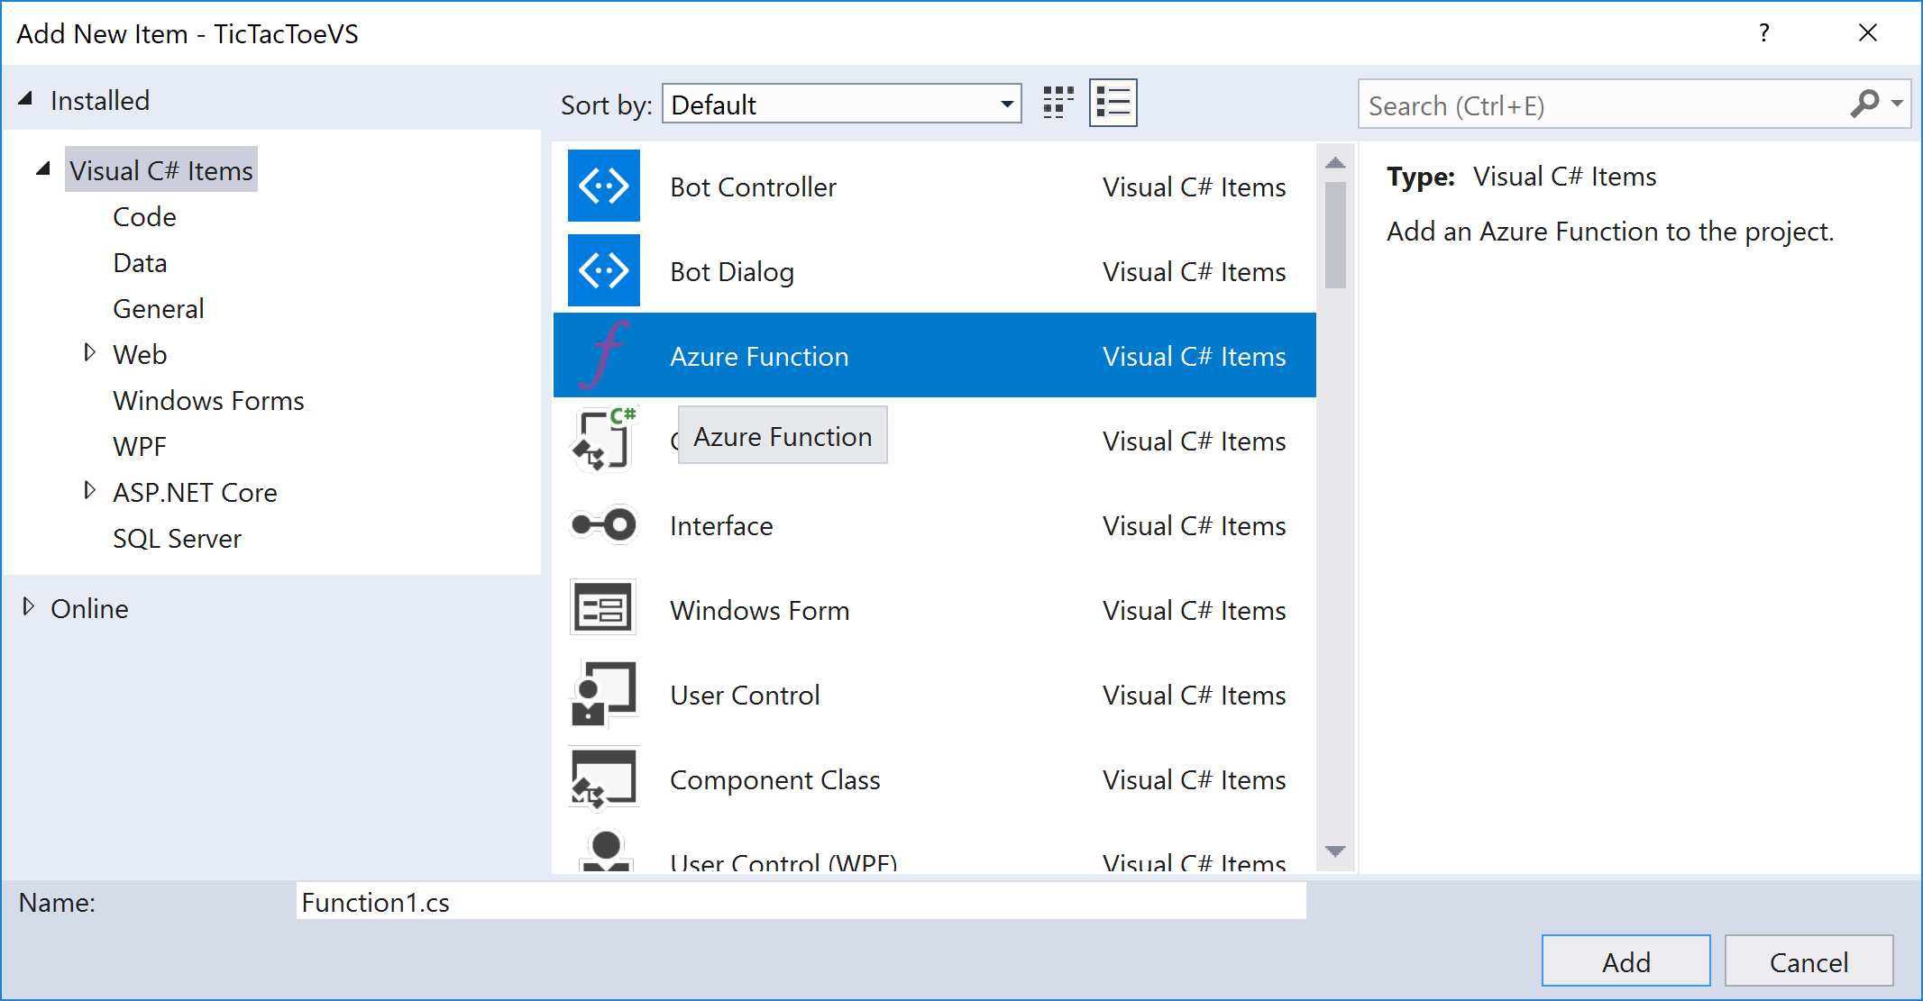
C# Function
Develop in Visual Studio
Create Function App
Visual Studio
Debugging with VS
Deploy using VS

Slide 17
Node.js Function
func init --no-source-control
func templates list
func new
-> Answer wizard questions (Node.js)
func start
Local Development
Create Function App
Node.js
Call via HTTP (Insomnia)

Slide 18
Node Function
module.exports = function (context, req) {
// Parse request body
var board = JSON.parse(req.body);
// Make sure that body is a properly formed array
if (Array.isArray(board) && board.length == 9) {
// Body is ok -> send message to trigger analysis
context.bindings.outputSbMsg = { Message: board };
// Send OK result to caller
context.res = { status: 202 };
context.done();
}
else {
// Body is malformed -> send Bad Request to caller
context.res = { status: 400, body: "No valid tic-tac-toe board" };
context.done();
}
};
TicTacToe Validator
Create Queue Binding
Call via HTTP (Insomnia)

Slide 19
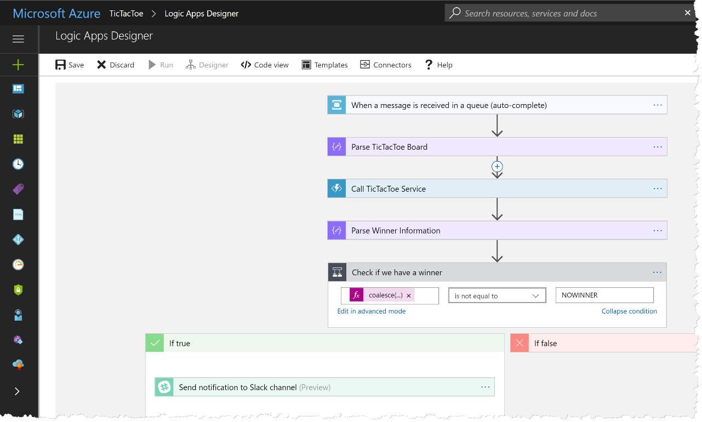
Logic App
Combine Functions with Workflows
Create function
Connect with Service Bus
Views
Design View
Code View

Slide 20
Logic App
"triggers": {
"When_a_message_is_received_in_a_queue_(auto-complete)": {
"inputs": {
"host": {
"connection": {
"name": "@parameters('$connections')['servicebus']['connectionId‘]“
}
},
"method": "get",
"path": "/@{encodeURIComponent(encodeURIComponent('tictactoe-request'))}/messages/head",
"queries": {
"queueType": "Main"
}
},
"recurrence": {
"frequency": "Second",
"interval": 15
},
"type": "ApiConnection"
}
}
TicTacToe Validator

Slide 21
Logic App
"Parse_TicTacToe_Board":{
"inputs":{
"content":"@base64toString(triggerBody()?['ContentData'])",
"schema":{
"properties":{
"Message":{
"items":{
"type":"string"
},
"type":"array"
}
},
"type":"object"
}
},
"runAfter":{
},
"type":"ParseJson"
}
TicTacToe Validator

Slide 22
Logic App
"Call_TicTacToe_Service":{
"inputs":{
"body":"@body('Parse_TicTacToe_Board')?['Message']",
"function":{
"id":"/subscriptions/26400a43-e689-48df-95dc-0b173a362cff/resourceGroups/serverless-hagenberg/providers/Microsoft.Web/sites/serverless-demo-func/functions/TicTacToe"
},
"headers":{
"x-functions-key":"zV6jby5icU3PaAx0...JgbOYef12Cqh3qD3zrvC/Q=="
},
"method":"POST"
},
"runAfter":{
"Parse_TicTacToe_Board":[
"Succeeded"
]
},
"type":"Function"
}
TicTacToe Validator

Slide 23
Logic App
"Parse_Winner_Information":{
"inputs":{
"content":"@body('Call_TicTacToe_Service')",
"schema":{
"properties":{
"winner":{
"type":"string"
}
},
"type":"object"
}
},
"runAfter":{
"Call_TicTacToe_Service":[
"Succeeded"
]
},
"type":"ParseJson"
}
TicTacToe Validator

Slide 24
Logic App
"Check_if_we_have_a_winner":{
"actions":{
"Send_notification_to_Slack_channel":{
"inputs":{
"host":{
"connection":{
"name":"@parameters('$connections')['slack']['connectionId']"
}
},
"method":"post",
"path":"/chat.postMessage",
"queries":{
"channel":"C02FJAB8J",
"text":"@{body('Parse_Winner_Information')?['winner']} is the winner"
}
},
"runAfter":{
},
"type":"ApiConnection"
}
},
"expression":"@not(equals(coalesce(body('Parse_Winner_Information')?['winner'], 'NOWINNER'), 'NOWINNER'))",
"runAfter":{
"Parse_Winner_Information":[
"Succeeded"
]
},
"type":"If"
}
TicTacToe Validator

Slide 25
What Else?

Slide 26
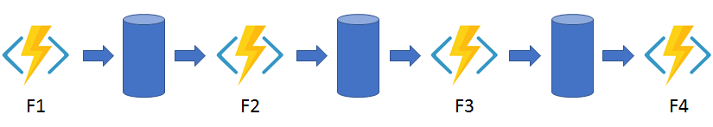
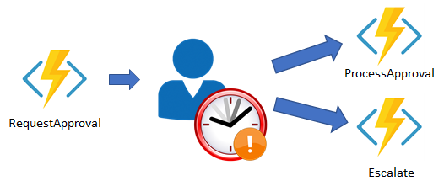
Durable Functions (Preview)
Function Chaining
Human Interaction
https://docs.microsoft.com/en-us/azure/azure-functions/durable-functions-overview

Slide 27
Summary

Slide 28
Image Source: https://flic.kr/p/73eSV7

Slide 29
Q&A
Strom kommt aus der Steckdose und IT aus der Cloud
Rainer Stropek
software architects gmbh
Mail Web Twitter
rainer@timecockpit.com http://www.timecockpit.com @rstropek
Thank your for coming!

